Slide 1
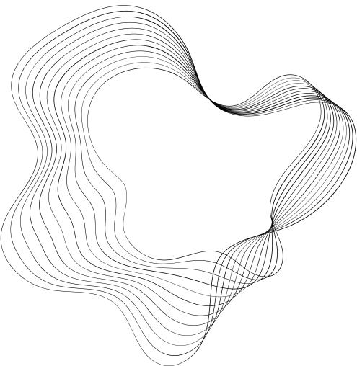

Handwritten Digit Recognition

Slide 2
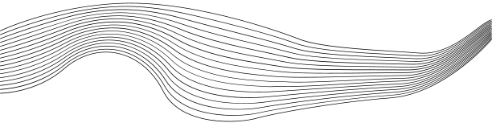
TEAM MEMBERS
01
GANESH REDDY JANGA
02
SHAIK INTIYAZ
03
VEDASRAVAS

Slide 3
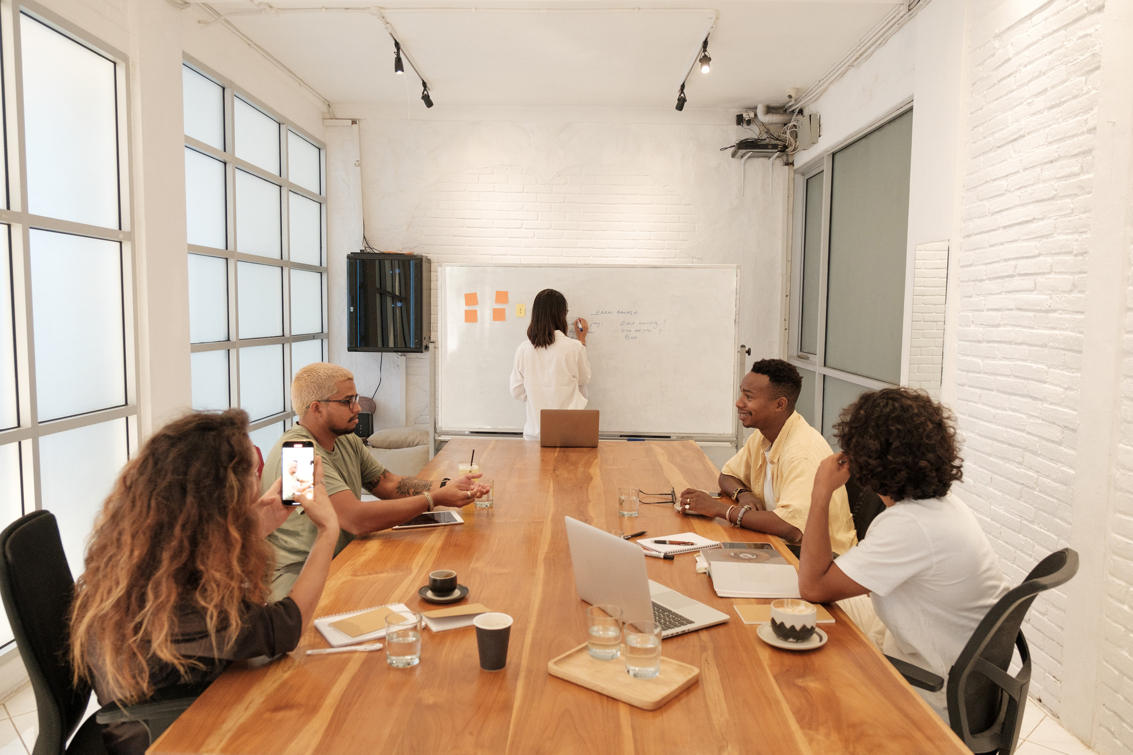

INTRODUCTION
Deciphering handwritten content gains crucial importance in today's data-driven era.

Slide 4
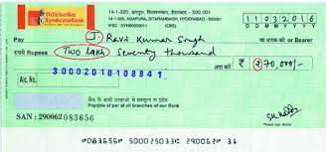
MOTIVATION/ USE CASE
The motivation for our Handwritten Digit Recognition project lies in its versatile applications, from enhancing efficiency in financial transactions by recognizing handwritten numbers on checks to automating grading in education and facilitating accurate mail sorting in postal services.
The project addresses real-world needs across various domains, emphasizing its practical significance.

Slide 5
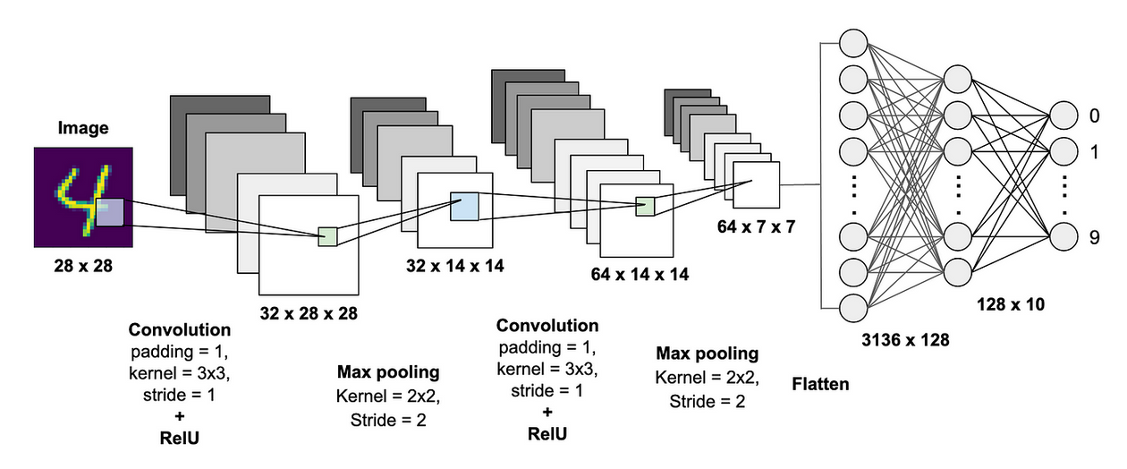
METHODOLOGY
Our methodology revolves around implementing Convolutional Neural Networks (CNNs) for Handwritten Digit Recognition. Initially, we preprocess the data, extracting key features and normalizing inputs. Subsequently, we design and train the CNN model, optimizing it to capture intricate patterns in diverse handwriting styles.

Slide 6
RESOURCES
Programming Language: Python
Deep Learning Framework: TensorFlow or PyTorch
Libraries: NumPy, Matplotlib, OpenCV
Dataset: MNIST dataset from Keras Library
Development Environment: Jupyter Notebooks or IDE.

Slide 7
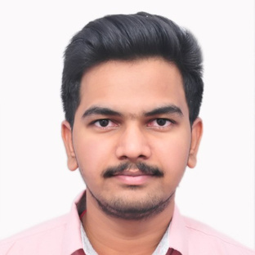
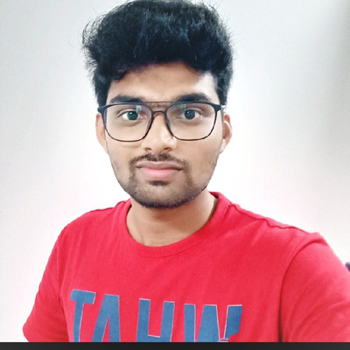
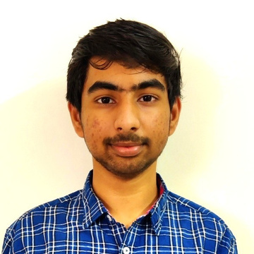
INDIVIDUAL CONTRIBUTION
GANESH REDDY JANGA
Led the project, Designed and developed the graphical user interface (GUI) using Tkinter for seamless user interaction.
SHAIK INTIYAZ
Spearheaded the preprocessing of the MNIST dataset, ensuring optimal feature extraction.
VEDASRAVAS
Implemented the core functionality of the Convolutional Neural Network (CNN) for digit recognition.

Slide 8
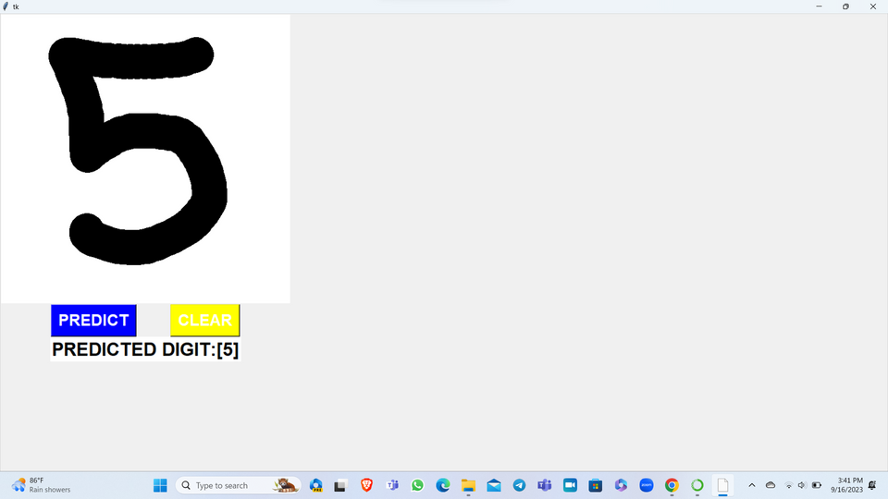
EXPECTED OUTCOMES
Our project aims to deliver a robust Handwritten Digit Recognition system with a Tkinter-based user interface. The expected outcomes include a high-accuracy Convolutional Neural Network model capable of recognizing diverse handwriting styles. Users will experience an intuitive GUI where they can draw digits for real-time predictions, contributing to a user-friendly and versatile application.

Slide 9
FUTURE WORK
Future work involves exploring advanced neural network architectures to further enhance recognition accuracy and adaptability to varied writing styles.

Slide 10

THANK'S FOR WATCHING

